Slide 2
Android Introduction
Peter Larsson-Green
Jönköping University
Spring 2020

Slide 3
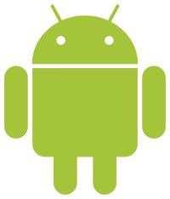
The Android Story
2005:
July: Google buys Android Inc.
2007:
June: Apple releases iPhone.
November: Open Handset Alliance established.
Mission: to develop open standards for mobile devices.
Flagship: Android
2008:
October: First device running Android: HTC Dream

Slide 4
The Android Success
http://www.idc.com/prodserv/smartphone-os-market-share.jsp

Slide 5
Is android open source?
Android is open source.
Android Open Source Project (AOSP):
https://source.android.com/index.html
Successfully forked by Amazon: Fire OS.
The name Android is a trademark of Google Inc.
https://developer.android.com/legal.html

Slide 6
Does google control Android?
Next version always developed behind closed doors.
Google has abandoned many original AOSP apps in favor of their own.
Google's apps are not part of AOSP; they are closed source.
Google improves Google Play Services instead of AOSP.
Many applications depends on Google Play Services.
Users ♥ Google's apps
Manufacturers wants Google's apps
Manufacturers dependent on Google
⇒
⇒

Slide 7
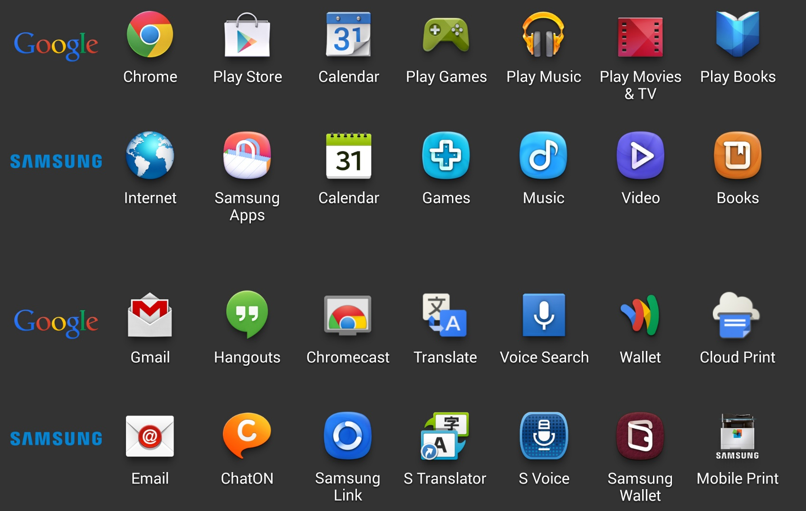
Samsung's plan b
http://arstechnica.com/gadgets/2013/10/googles-iron-grip-on-android-controlling-open-source-by-any-means-necessary/3/

Slide 8
Android
Smartphones
Tablets
Wear
TV
Auto
Things

Slide 9
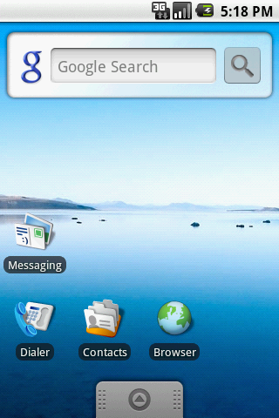
History lesson
2008, Android 1.0
Designed for mobile phones with touchscreen.
Can only handle single touch.
Four hardware buttons: Back, Home, Menu and Search.
Status bar at the top.
Title bar at the top of applications.
Android 1.5 added:
Widgets.
Accelerometer-based application rotations.
https://en.wikipedia.org/wiki/File:Android_1.5_Cupcake_Screenshot.png

Slide 10
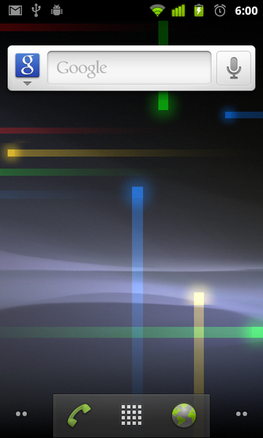
History lesson
2009, Android 2.0
Multi touch support.
Android 2.3 added:
Front camera support.
https://commons.wikimedia.org/wiki/File:Android_screenshot.png

Slide 11
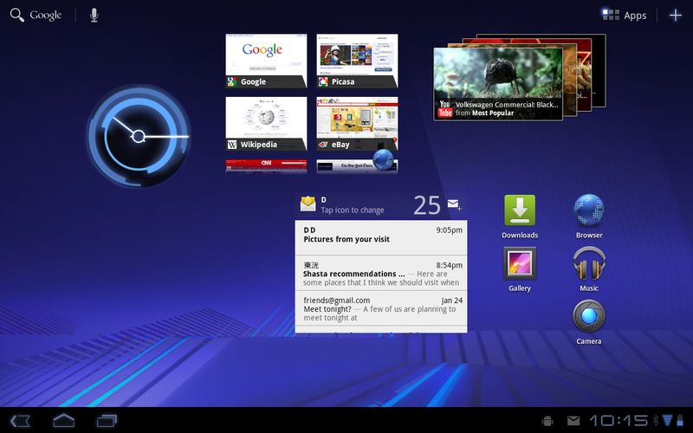
History lesson
2011, Android 3.0
Better tablet support.
Added system and action bar.
Software navigation buttons (in the system bar) instead of hardware buttons.
The Menu and Search buttons deprecated.
The Recent button added.
Android 3.1 added:
Resizable home screen widgets.
Has not been used on many devices.
https://commons.wikimedia.org/wiki/File:Android3.0.png

Slide 12
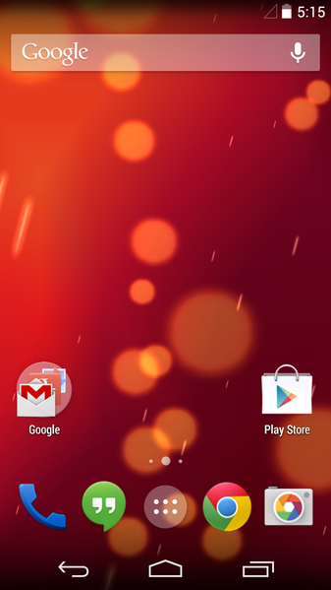
History lesson
2011, Android 4.0
Access applications directly from the lock screen.
Android 4.2 added:
Widgets on lock screen.
Multiple user accounts (only tablets).
https://commons.wikimedia.org/wiki/File:Android_4.4.4_KitKat.png

Slide 13
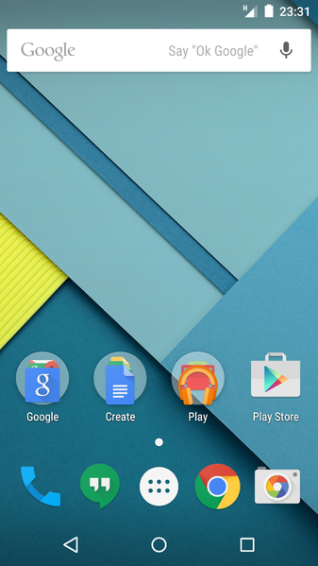
History lesson
2014, Android 5.0
Android RunTime (ART) replacing Dalvik.
User accounts for smartphones too.
Widgets no longer supported on lock screen.
Material design
https://commons.wikimedia.org/wiki/File:Android_5.0-en.png

Slide 14
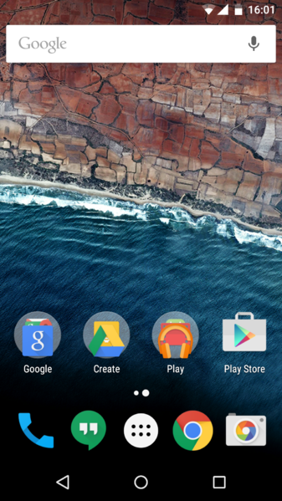
History lesson
2015, Android 6.0
Ask for permissions at runtime.
Fingerprint support.
https://commons.wikimedia.org/wiki/File:Android_6.0-en.png

Slide 15
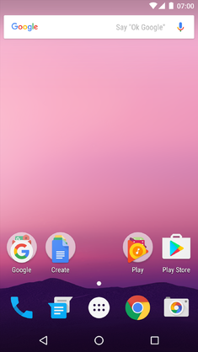
History lesson
2016, Android 7.0
Double tap overview button → Switch app
Multi-window
Android 7.1 added:
App shortcuts
https://upload.wikimedia.org/wikipedia/en/7/78/Android_7.0_Home_Screen.png

Slide 16
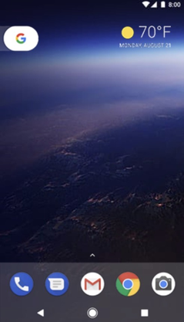
History lesson
2017, Android 8.0
Picture-in-picture.
Autofill framework.
https://en.wikipedia.org/wiki/File:Android_8.0_Oreo_Pixel.png

Slide 17
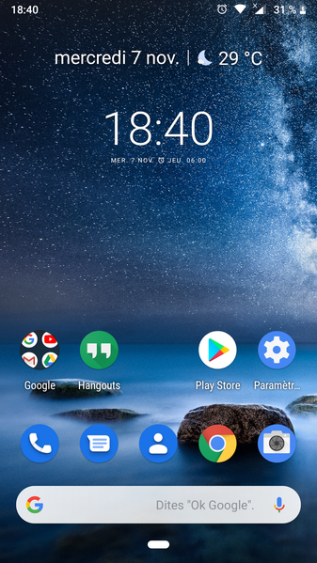
History lesson
2018, Android 9.0
New recent task list
The Dashboard
https://commons.wikimedia.org/wiki/File:Android_Pie_9.0_screenshot.png

Slide 18
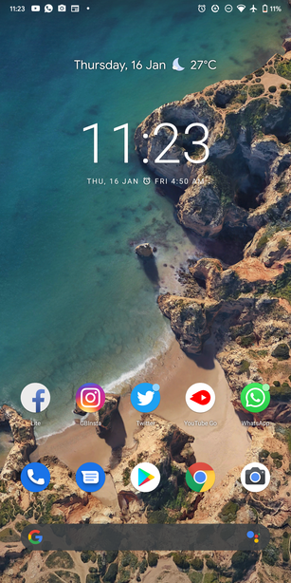
History lesson
2019, Android 10.0
Support for foldable devices.
Floating settings panel.
https://upload.wikimedia.org/wikipedia/commons/8/8a/Android_Q_Beta6_screenshot.png

Slide 19
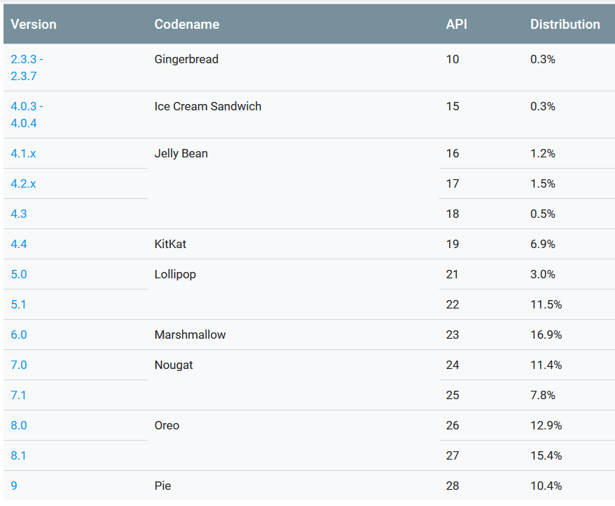
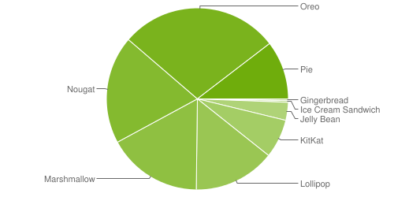
Platform versions today
Data collected during a 7-day period ending on May 7, 2019.
https://developer.android.com/about/dashboards/index.html

Slide 20
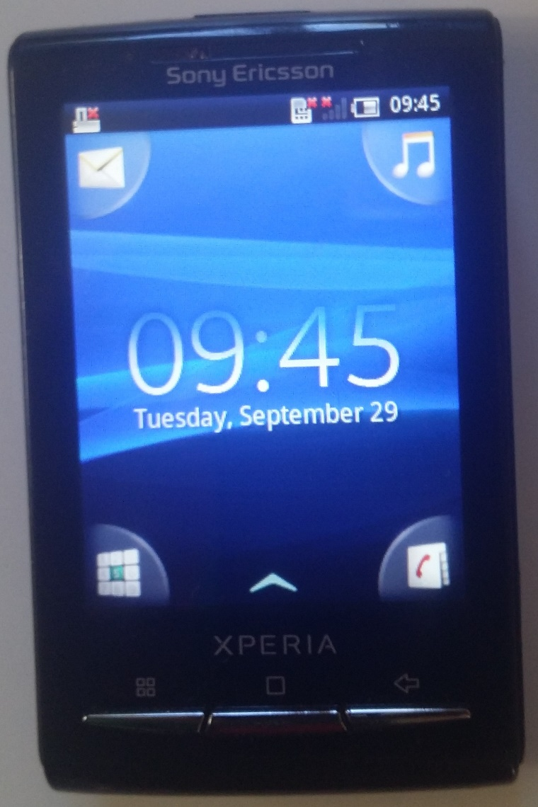
Different looks
Manufacturers usually customize Android a bit.
They use their own launcher application.
They use their own standard applications.
This does usually not matter for your own applications.

Slide 21
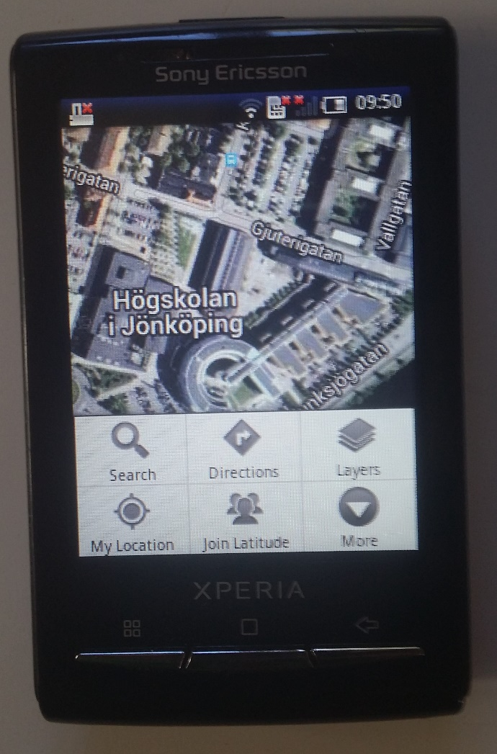
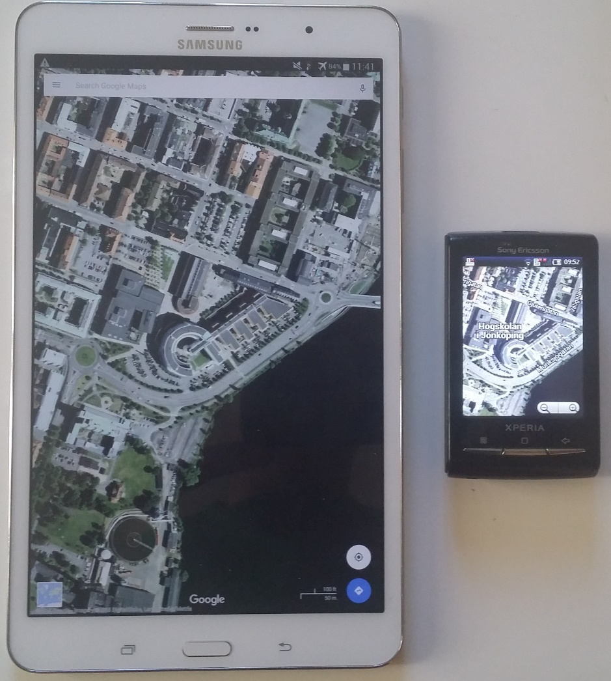
Old & new, small & large

Slide 22
Android fragmentation
https://www.opensignal.com/sites/opensignal-com/files/data/reports/global/data-2015-08/2015_08_fragmentation_report.pdf

Slide 23
iOS VS Android
Power button
Volume +
Volume +
Volume -
Volume -
Power button
Samsung Galaxy S6
iPhone SE
Recent apps (double click)
Recent apps
Back
Home Button
Home Button

Slide 24
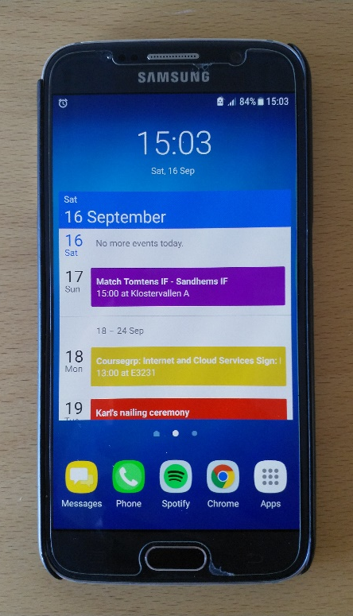
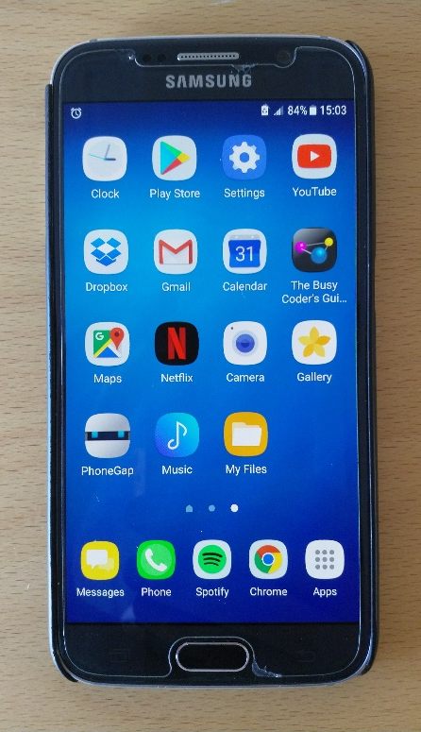
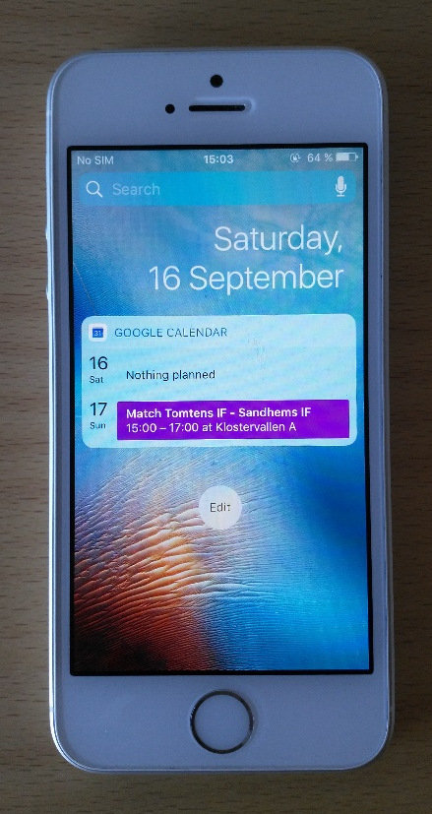
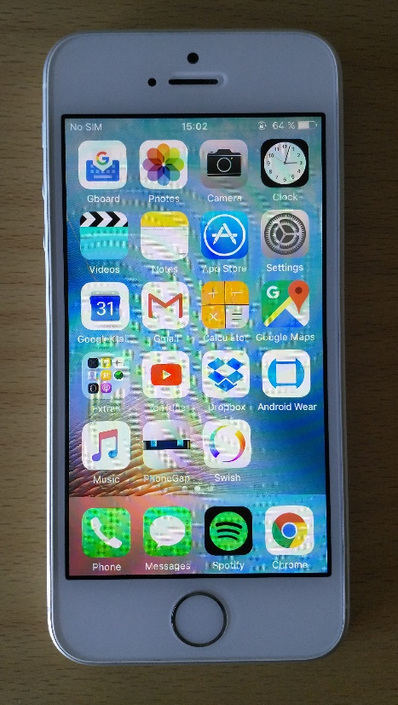
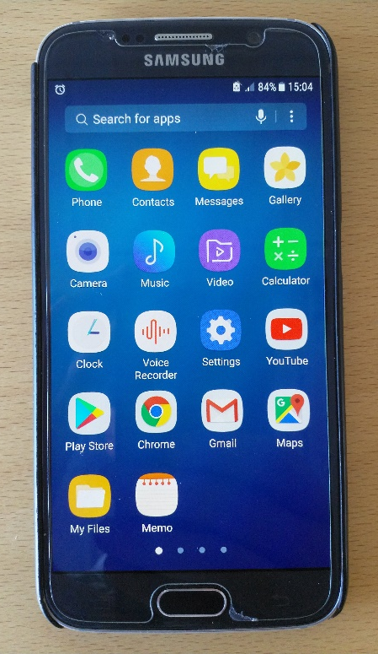
iOS VS Android
Swipe
Android widgets/ shortcuts
Swipe
Swipe
iOS widgets
iOS installed apps
Android installed apps

Slide 25
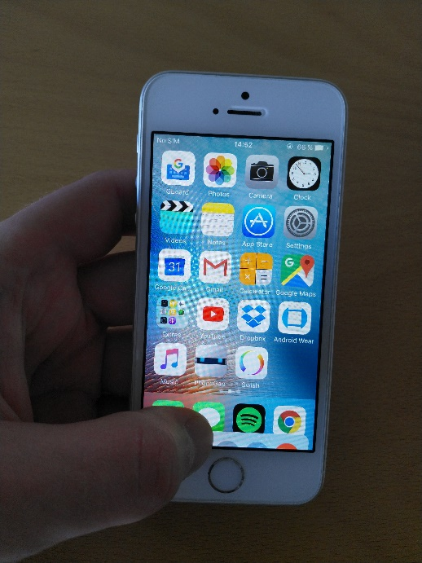
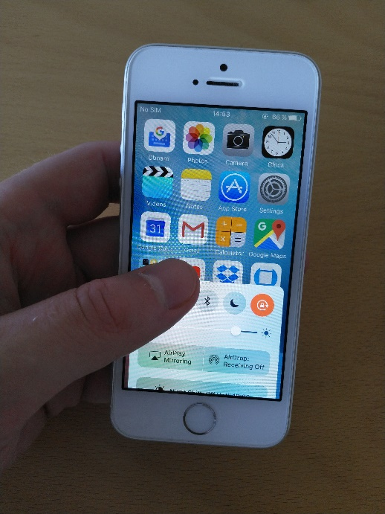
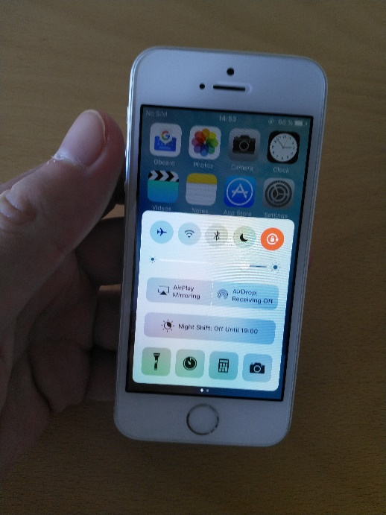
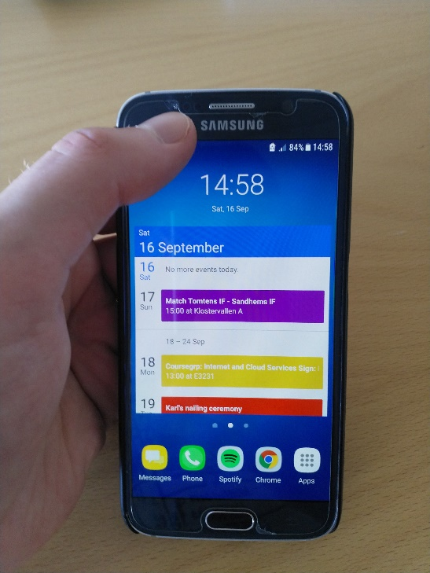
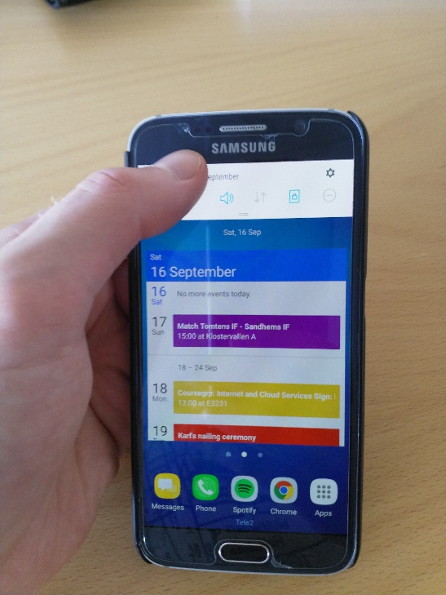
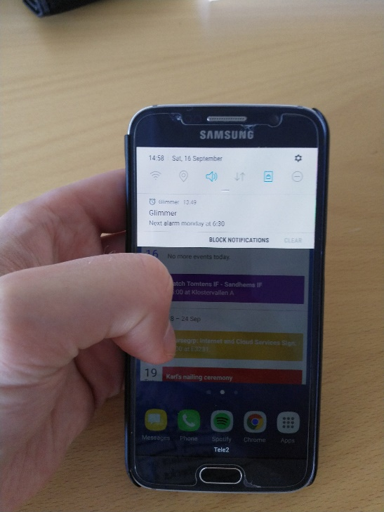
iOS VS Android
iOS Control Center
(pull up from button)
Android Status Bar
(pull down from top)

Slide 26
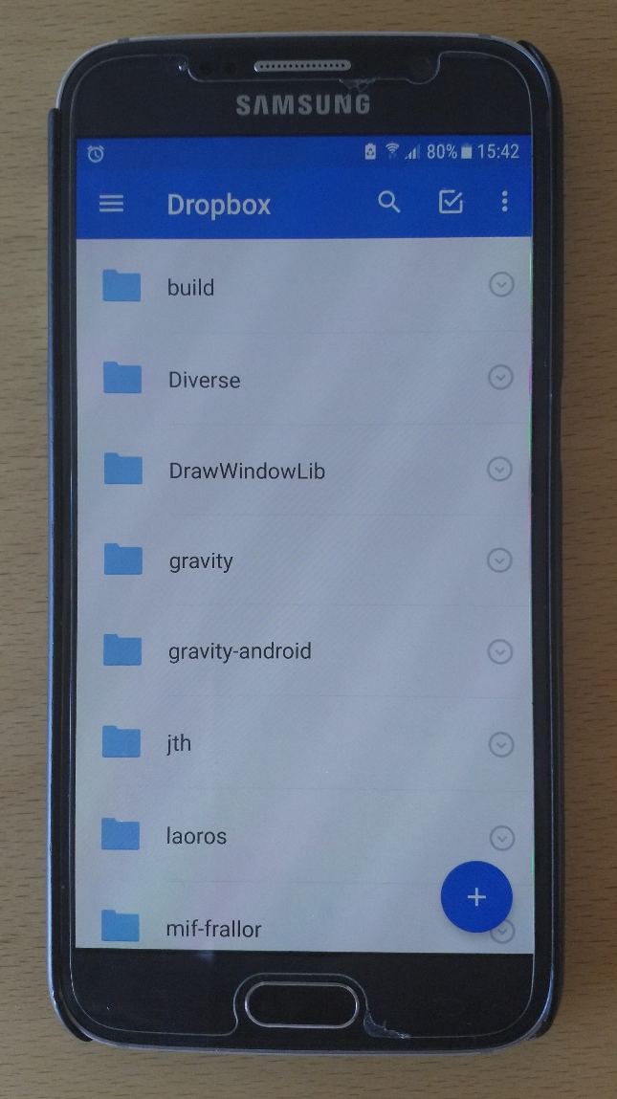
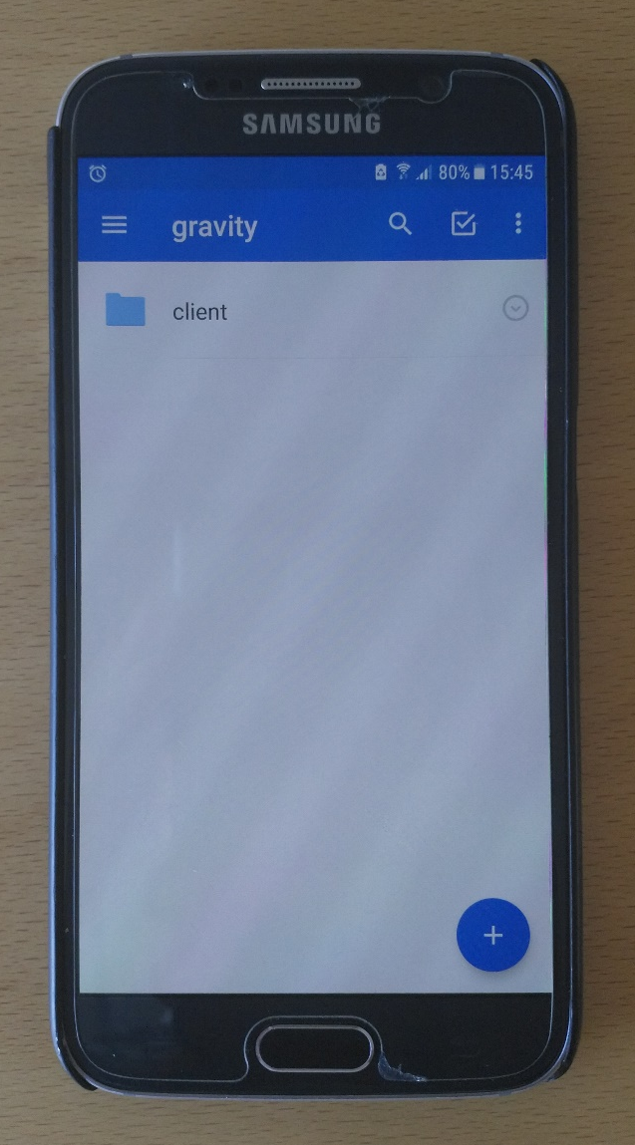
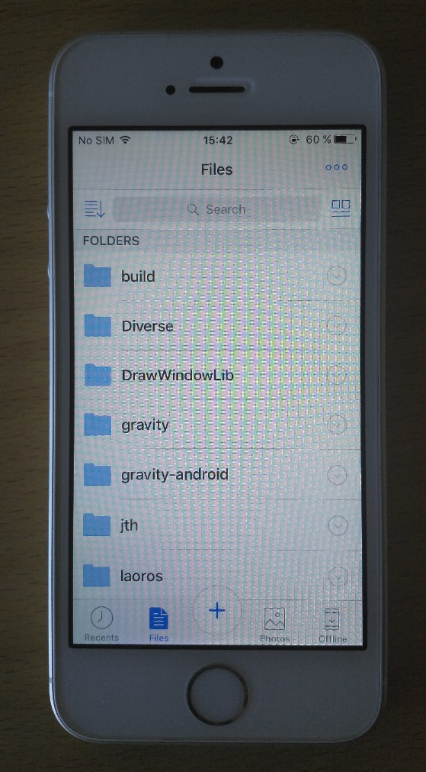
iOS VS Android
Click!
Click!
Click!
Click!

Slide 27
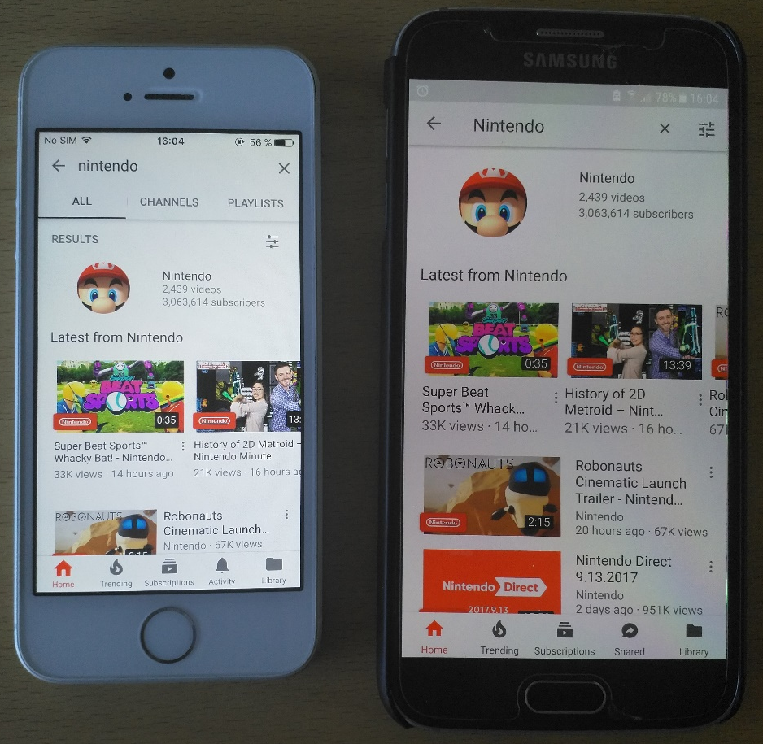
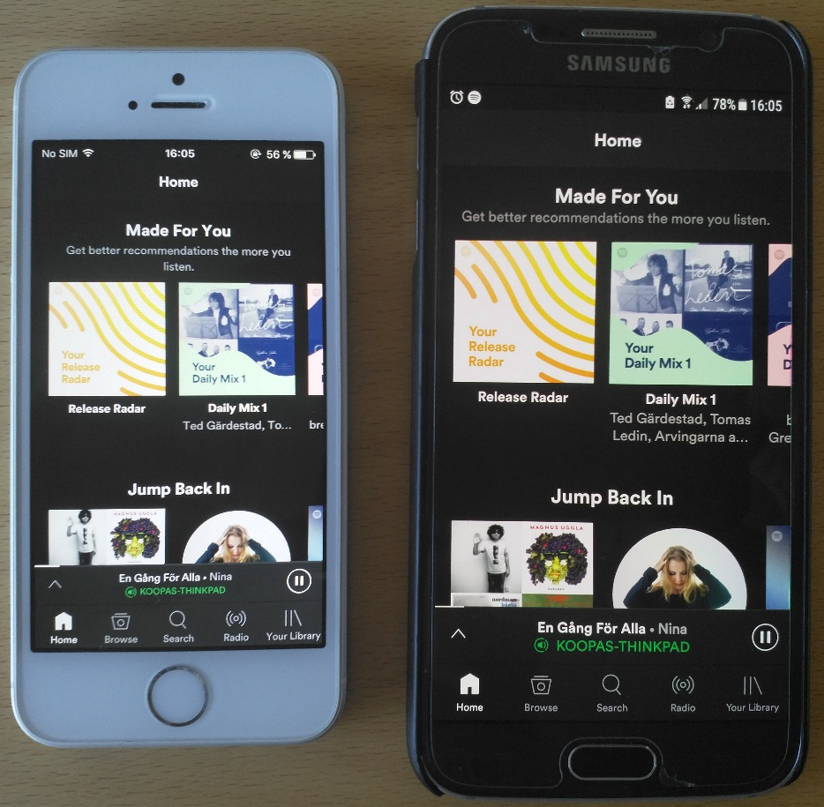
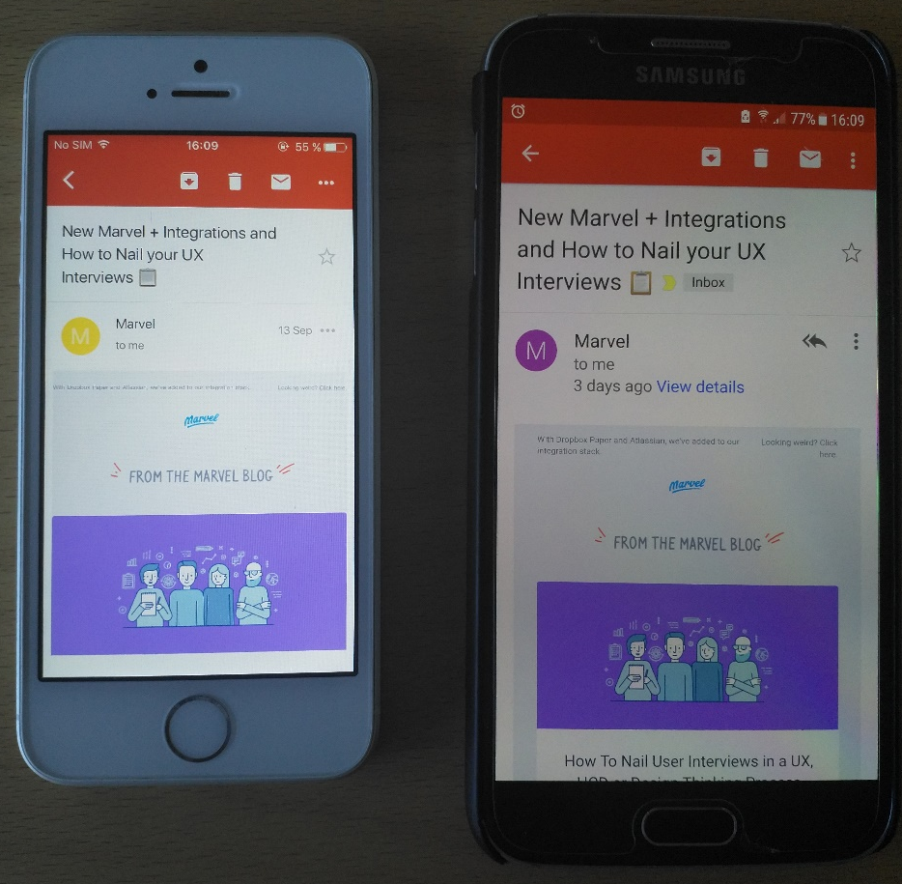
iOS VS Android
YouTube
(searching for Nintendo)
Spotify
(start screen)
Gmail
(reading an email)

Slide 28
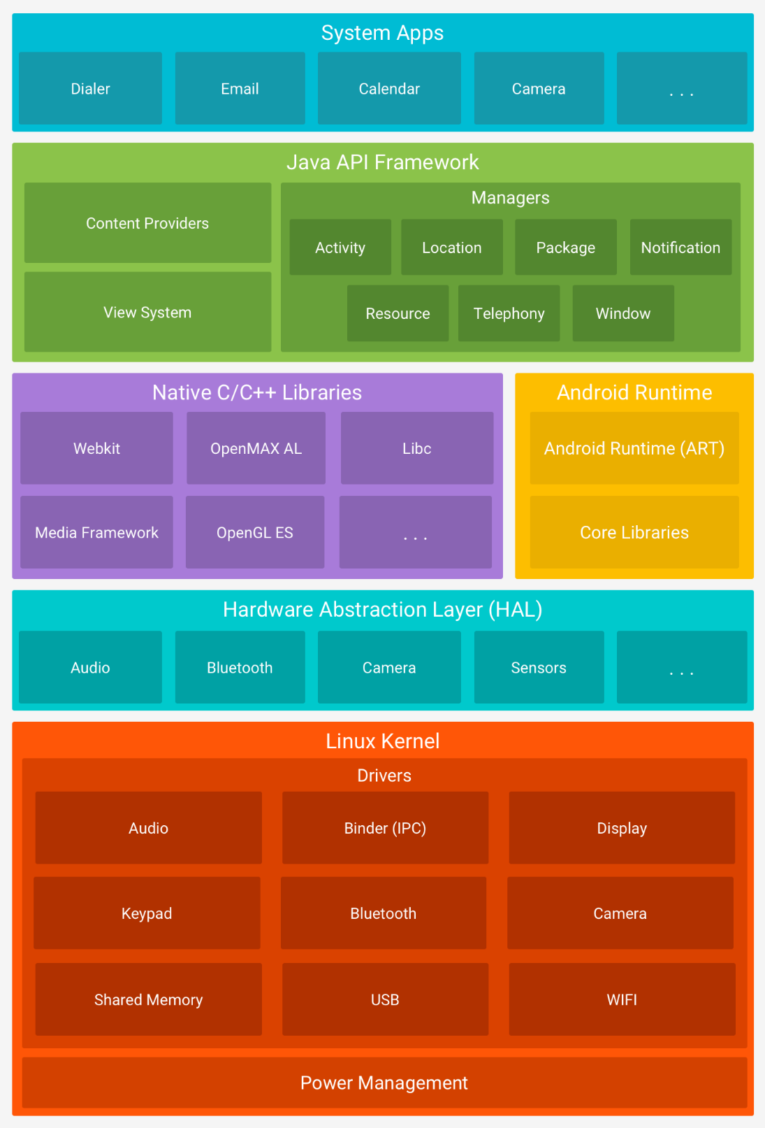
Android Architecture
Used by app developers
https://developer.android.com/guide/platform/index.html
AOSP developers improves Android everywhere
Each app run as its own Linux user.
App A can create files App B can't access.
OEM implements HAL

